Slide 1
Web Scraping using R Language

Slide 2
What is Web Scraping?
  Web scraping is a technique that allows us to extract information from websites automatically.
  Instead of manually copying and pasting content, web scraping uses code to fetch and parse the structure of a web page.

Slide 3
Implementation of Web Scraping using R
  We will use rvest library in R. Install the package rvest in your R Studio using the following code.
  install.packages(‘rvest’)
  To simplify web scraping, we can use an open-source browser extension called SelectorGadget. It helps identify CSS selectors for extracting specific elements from a webpage.
  You can install SelectorGadget. Once installed (preferably on Google Chrome), it will appear in the browser’s extension bar at the top right.

Slide 4
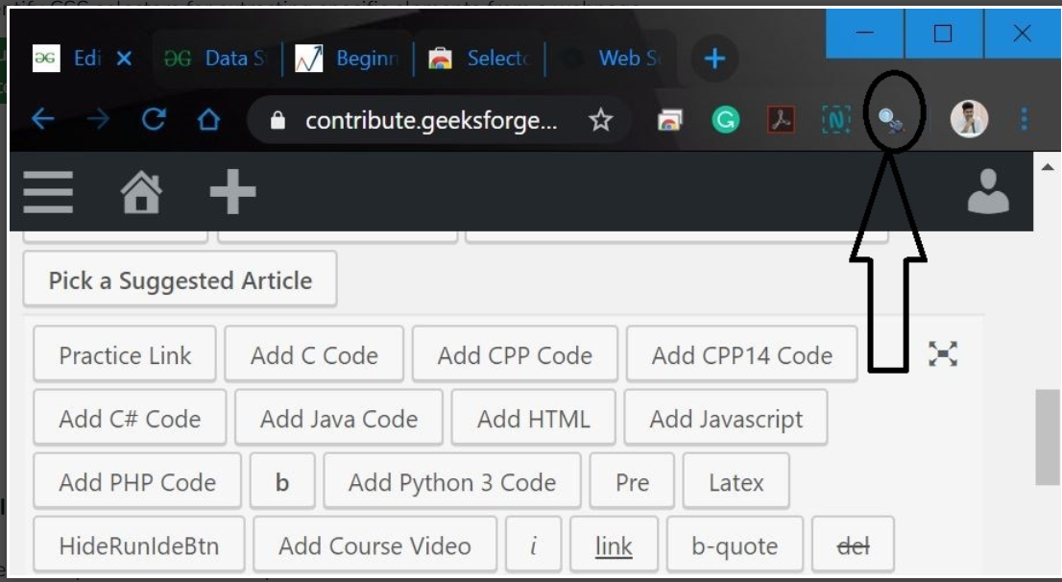
Implementation of Web Scraping using R

Slide 5
Implementation of Web Scraping using R
1. Import rvest libraries
We will import the rvest library.
library(rvest)
2. Read the Webpage
We will read the HTML code from the webpage using read_html(). Consider this webpage as a example.
webpage = read_html("https://www.geeksforgeeks.org /\data-structures-in-r-programming"))

Slide 6
Implementation of Web Scraping using R
3. Scrape Data From the Webpage
Now, let’s start by scraping the heading section. We will use SelectorGadget to identify the specific CSS selector that wraps the heading. Simply click on the extension in your browser and then click on the heading element, which will highlight the corresponding selector needed for scraping.

Slide 7
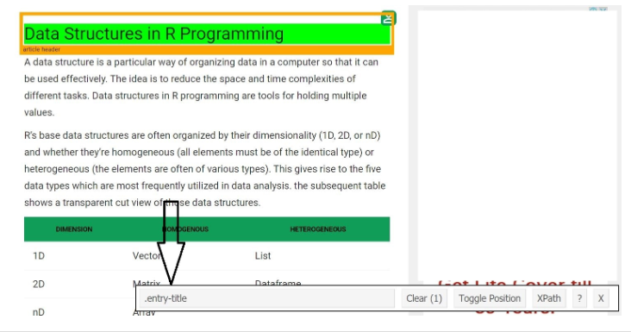
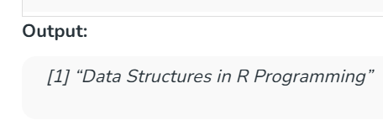
Implementation of Web Scraping using R
# Using CSS selectors to scrape the heading section
# Using CSS selectors to scrape the heading section
heading = html_node(webpage, '.entry-title’)
text = html_text(heading)
print(text)

Slide 8
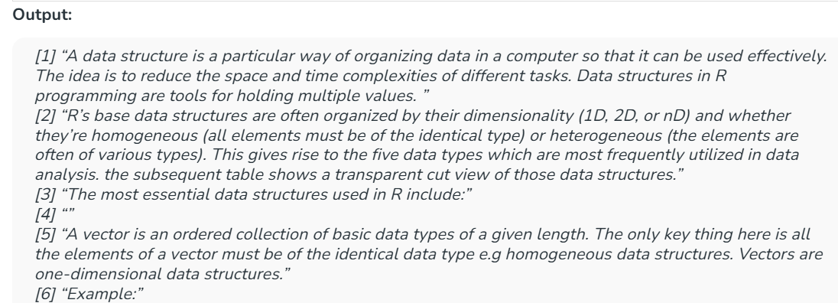
Implementation of Web Scraping using R
# Using CSS selectors to scrape
paragraph = html_nodes(webpage, 'p')
pText = html_text(paragraph)
print(head(pText))

